Slide 1
Image Captioning
(AI/ML Project)

Slide 2
Introduction
This project shows how Deep Learning can be used to solve the problem of generating a caption for a given image, hence the name Image Captioning.
There are many open source datasets available for this problem, like Flickr 8k (containing 8k images), Flickr 30k (containing 30k images), MS COCO (containing 180k images). Dataset used for this project is Flickr8k.
Used Inception and VGG16 models to extract features from the image which are then used as input our image captioning model.
The caption is predicted word by word using Recurrent Neural Networks. Used a default starting word ‘startseq’ to predict the next words.

Slide 3
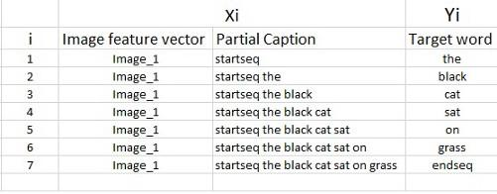
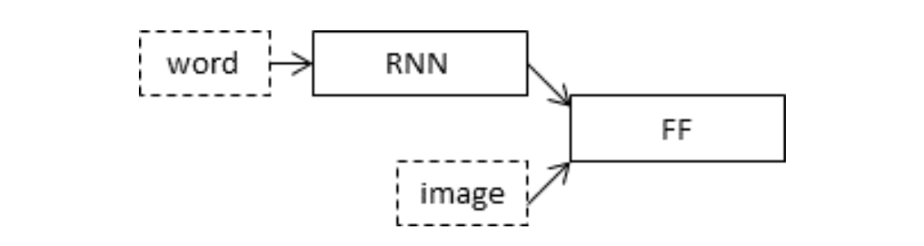

Slide 4
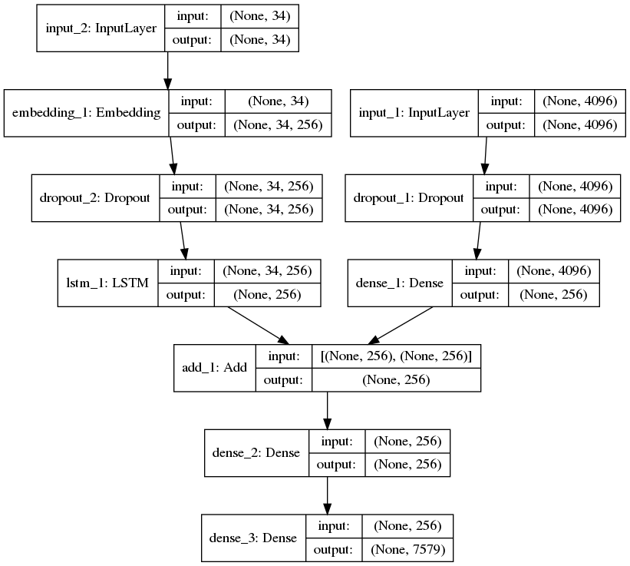
Model Architecture

Slide 5
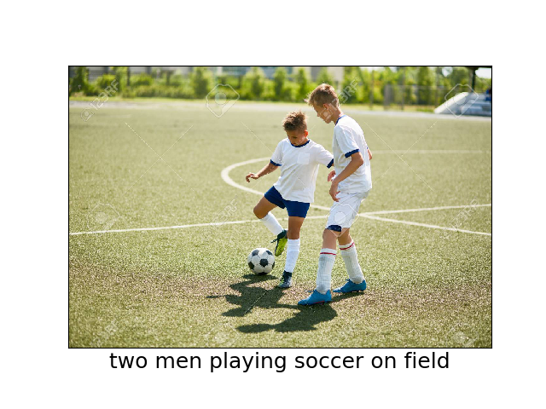
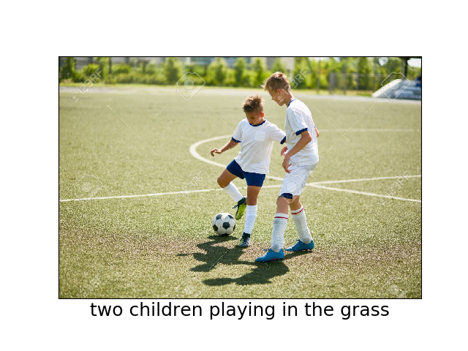
Example Results
Inception Model VGG16 Model

Slide 6
Evaluation Metric
We used BLEU metric to evaluate and measure the performance of our model. Our model approaches 0.59 , compared to human observation which is 0.69
BLEU scores for VGG16 model BLEU scores for Inception model
BLEU-1: 0.553138 BLEU-1: 0.541909
BLEU-2: 0.294281 BLEU-2: 0.289134
BLEU-3: 0.194568 BLEU-3: 0.194673
BLEU-4: 0.083649 BLEU-4: 0.087262

